Slide 1
SCRIPT: Infrastructure & Design
Bioinformatics and Data Management Core
Presenter: Mengjia Kang (Marjorie)
Notes:
MK - NS -collaboration

Slide 2

Agenda
Architecture - Graph DB and Web Application
Entity-Relationship Diagram (ERD) – REDCap Study Records
Next steps
Notes:
Mainly – then – at the end

Slide 3
Architecture – Graph DB and Web application

Slide 4
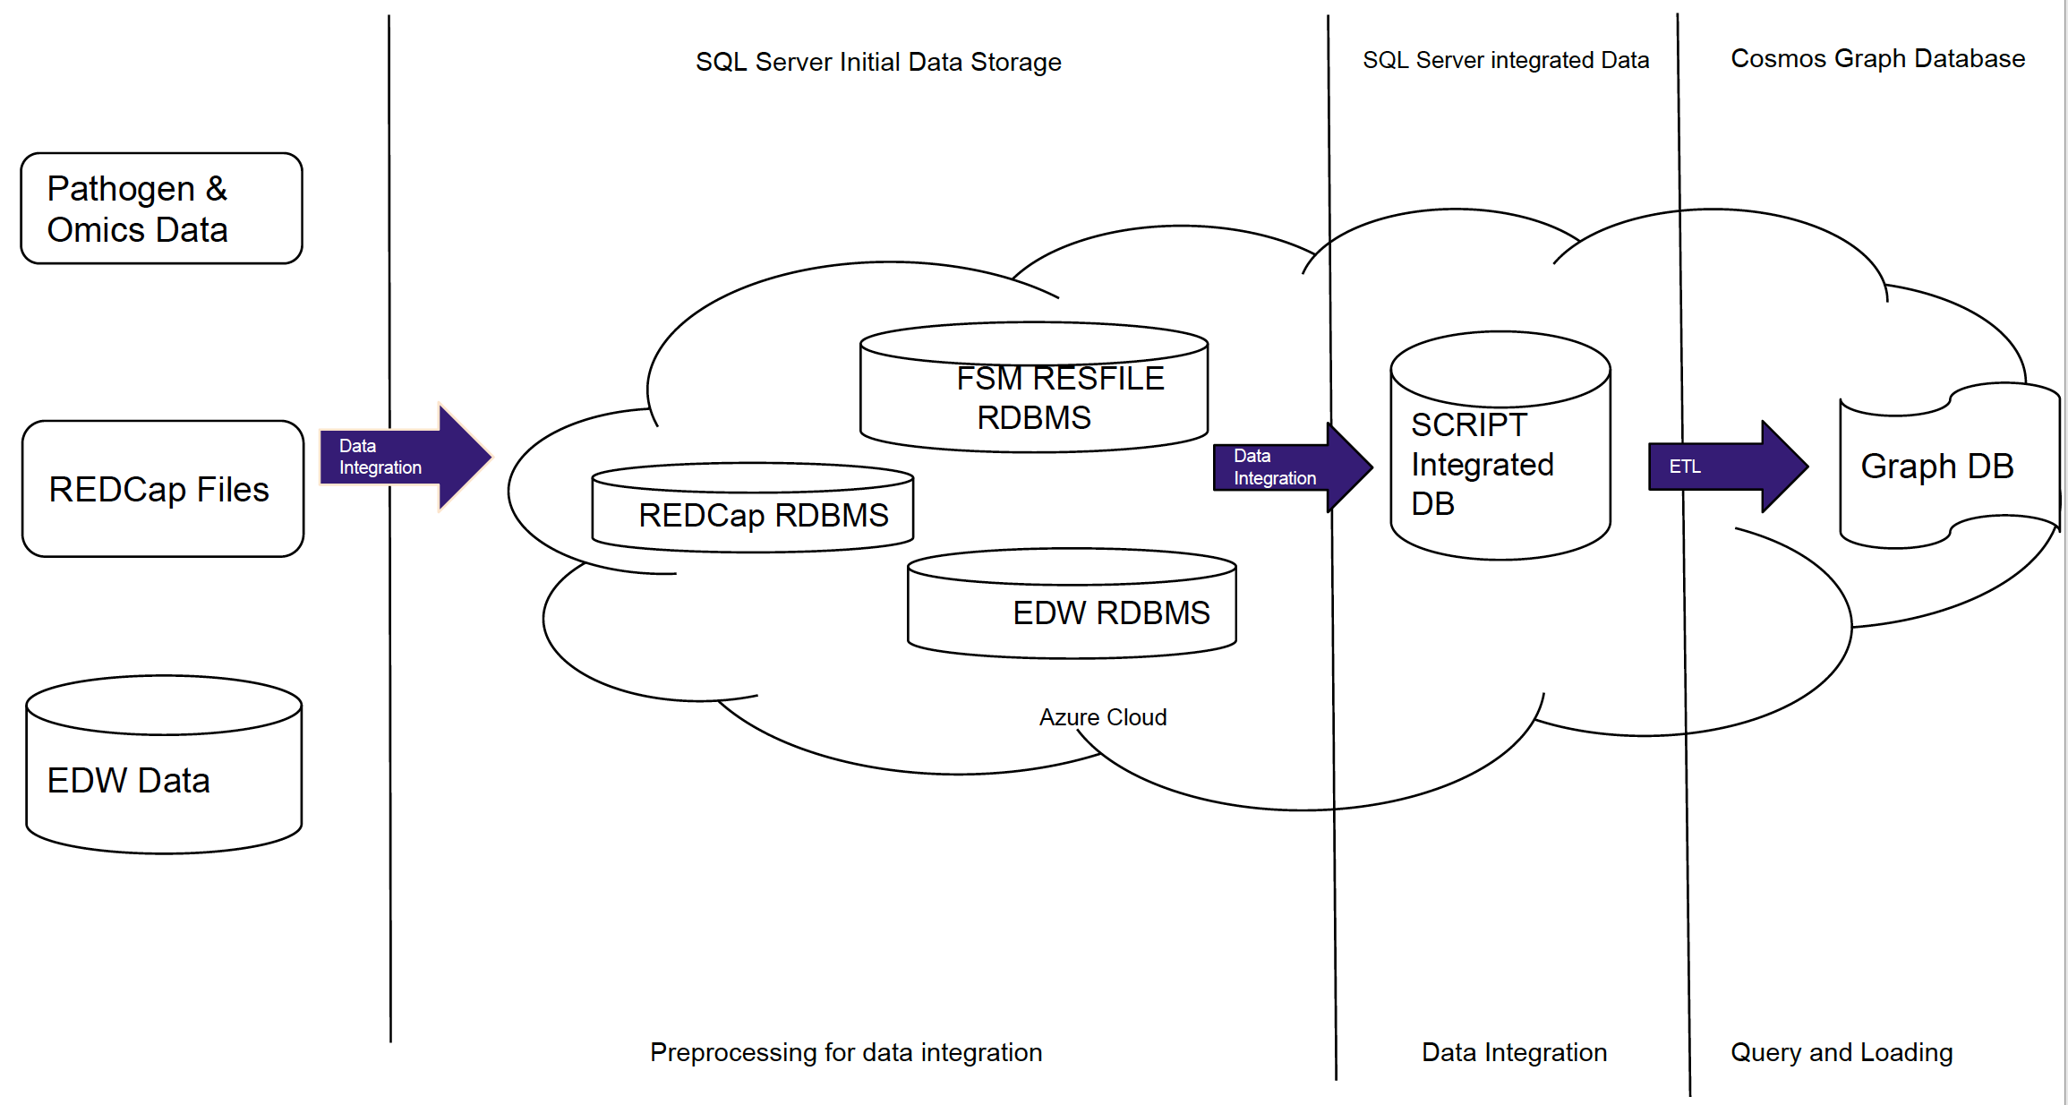
High level view
Notes:
FSM IT & Azure had Collaboration for teaching purposes

Slide 5
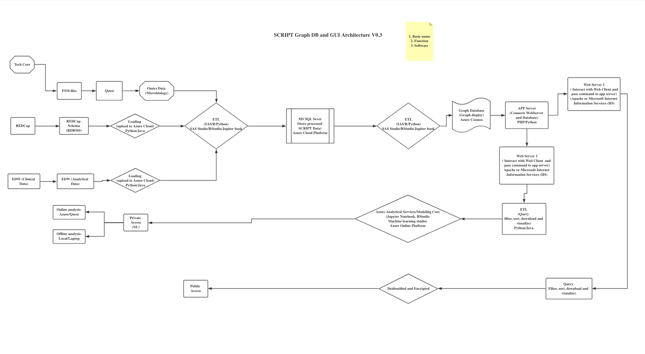
Down into details

Slide 6
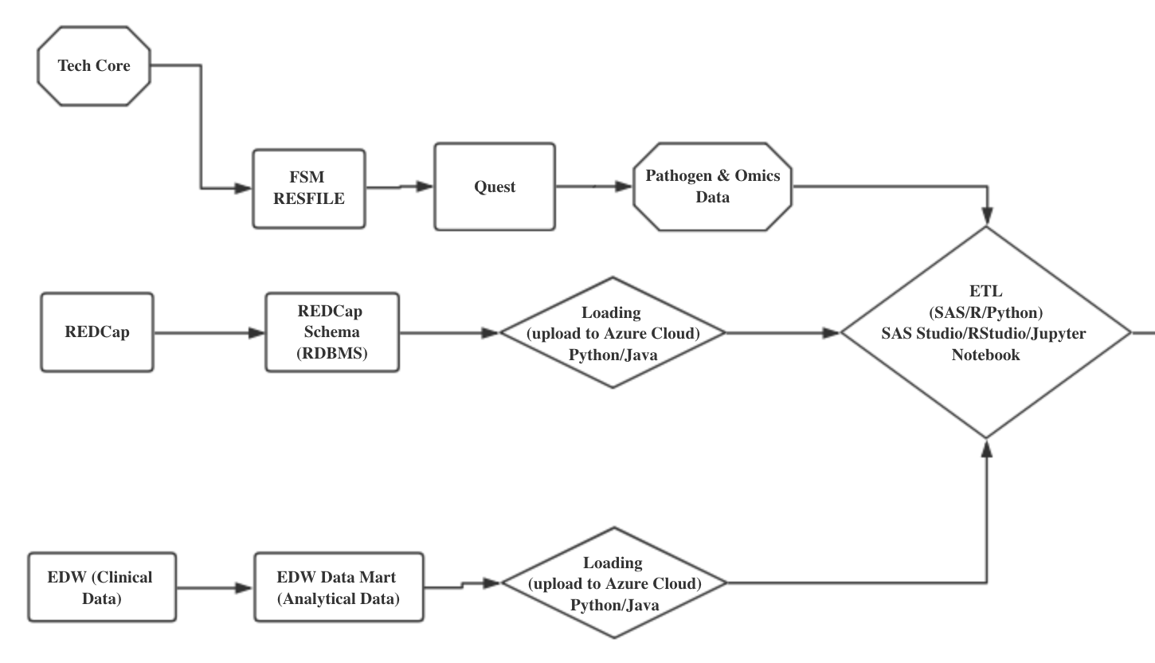
Part1 Server Side - Integrating Three Data Sources
Notes:
Data sources – Quest~~explain -

Slide 7
Down into details

Slide 8
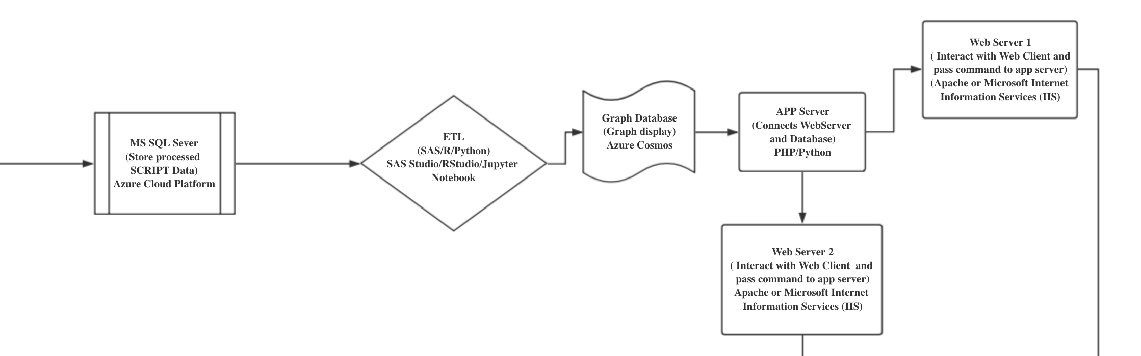
Part2 Web application Design

Slide 9
Down into details

Slide 10
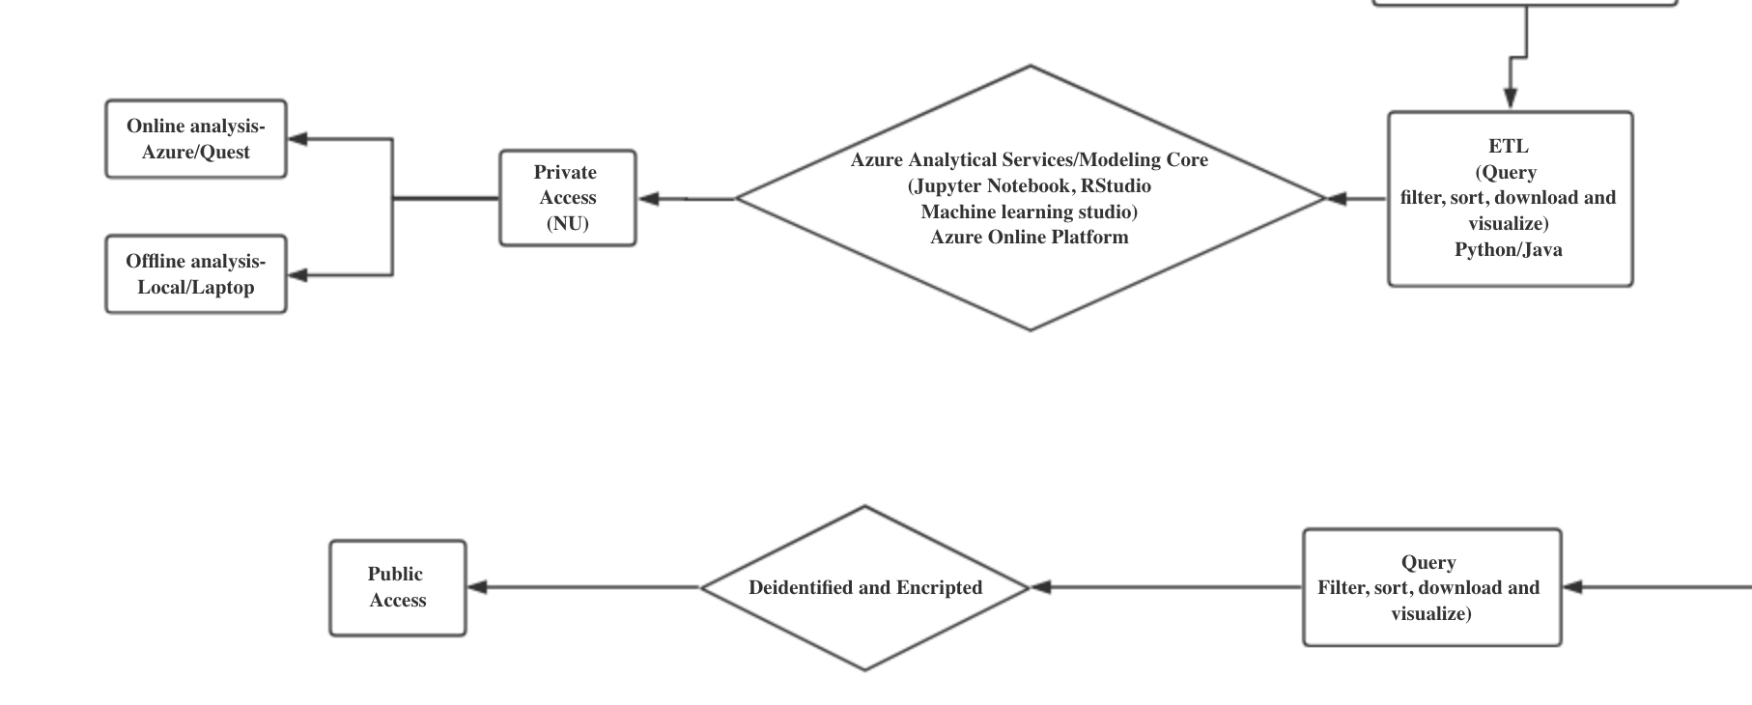
Part3 Modeling Core (NU Access) and Public access

Slide 11
Entity-Relationship Diagram (ERD) - REDCap

Slide 12
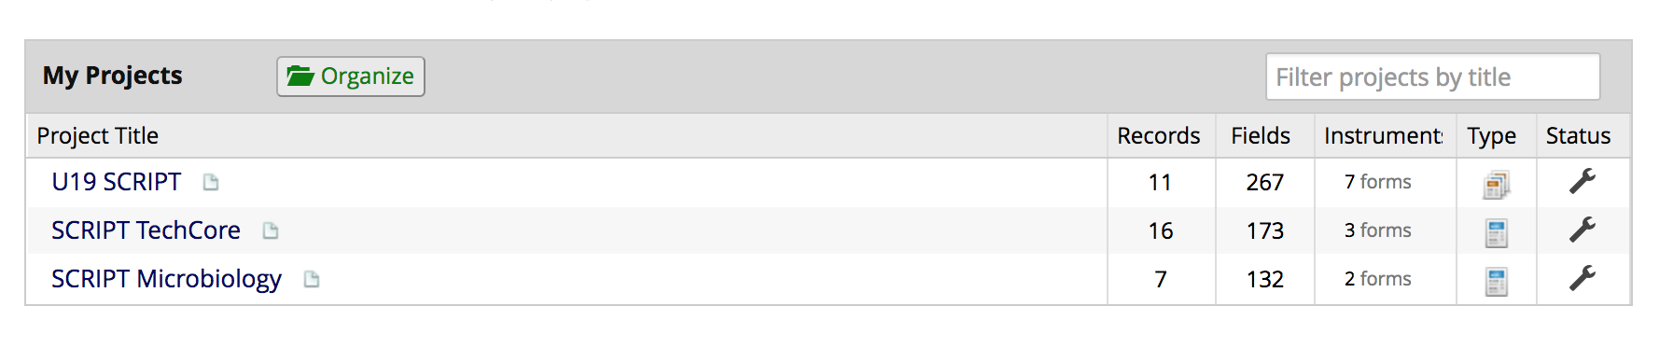
REDCap Projects
Notes:
3projects - records

Slide 13
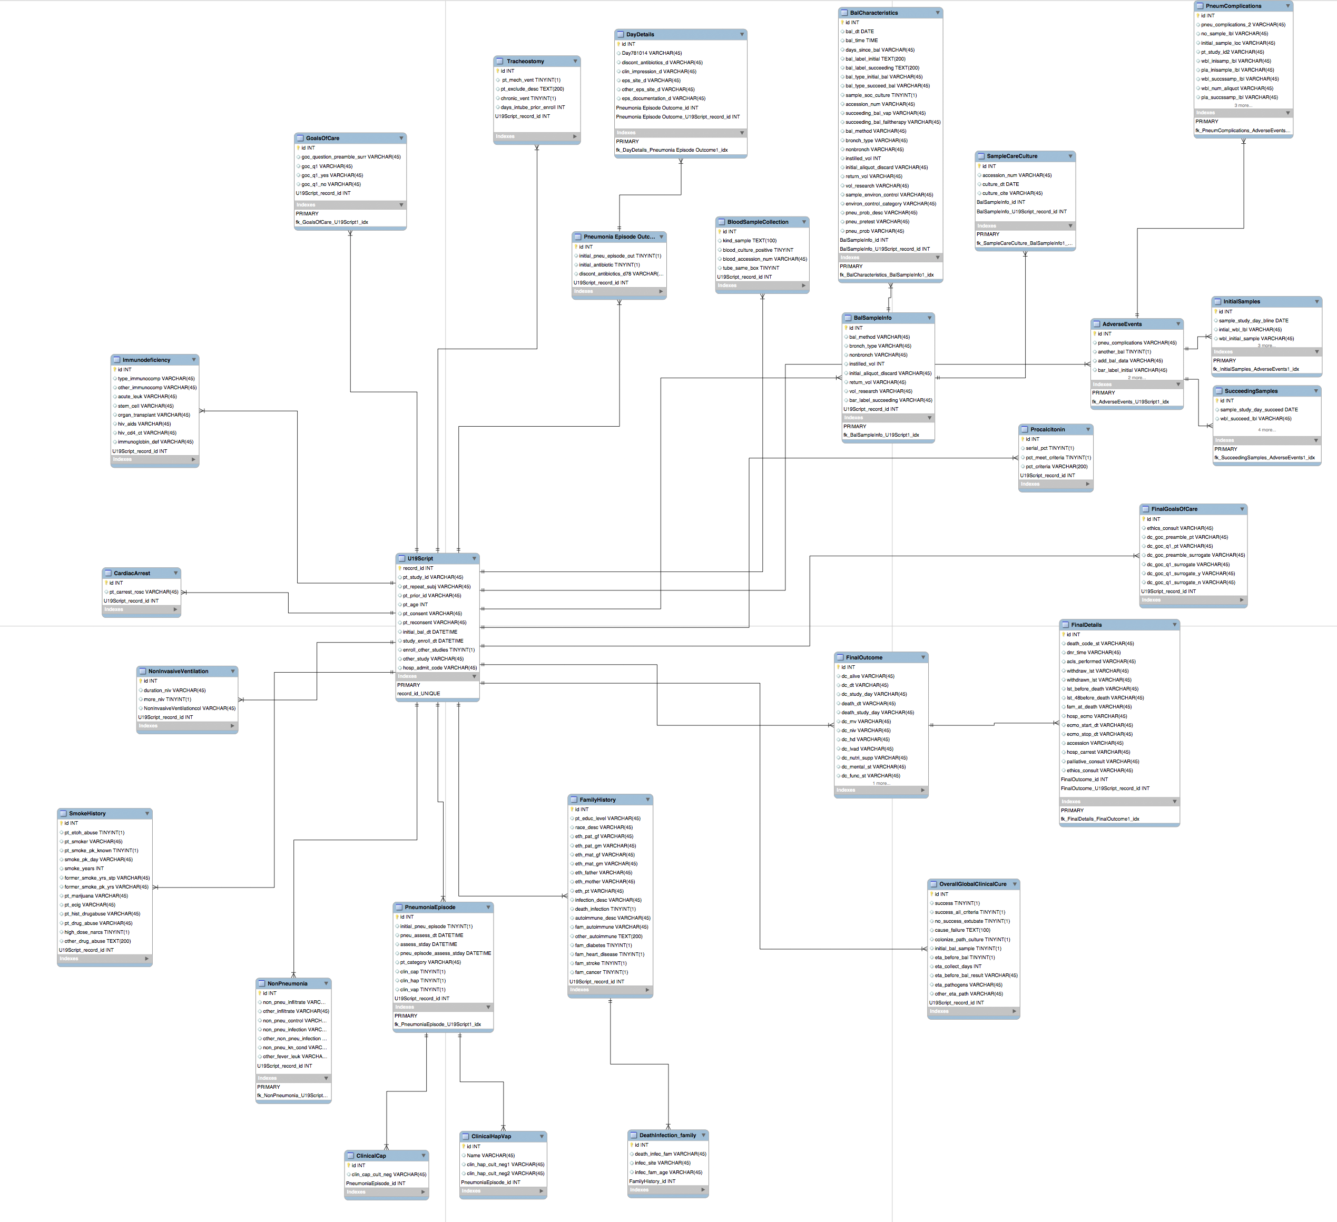
Study data– REDCap 1
Basic structure of U19 data
E-R diagram overview
Divide into two parts to explain
Notes:
E-R-D m-m, 1:m, 1-1

Slide 14
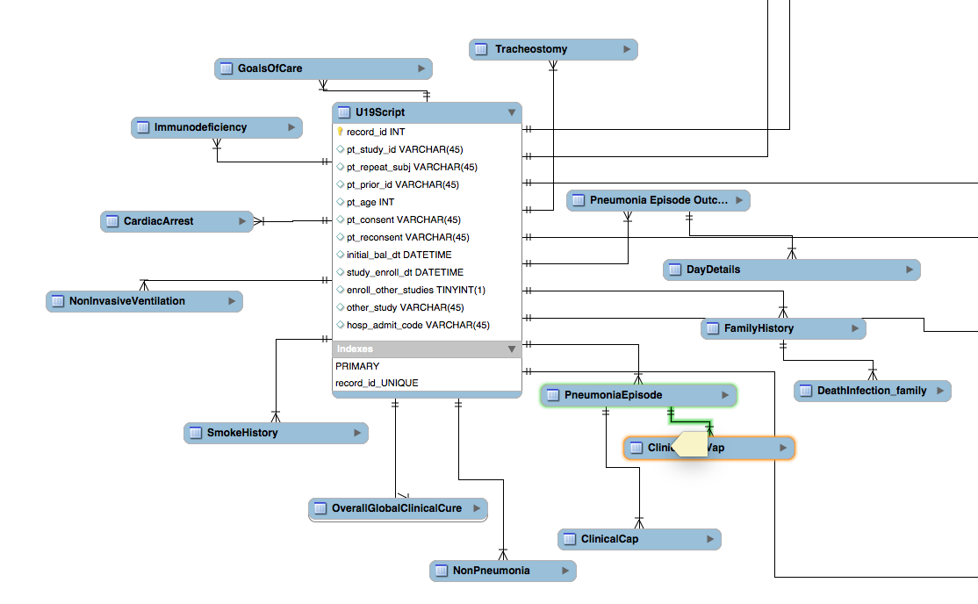
Study Records– REDCap 1A
Basic structure of U19 data
Leverage Redcap DB
Ties form data to Record ID
Patient disease History
Family History
Basic Clinical details

Slide 15
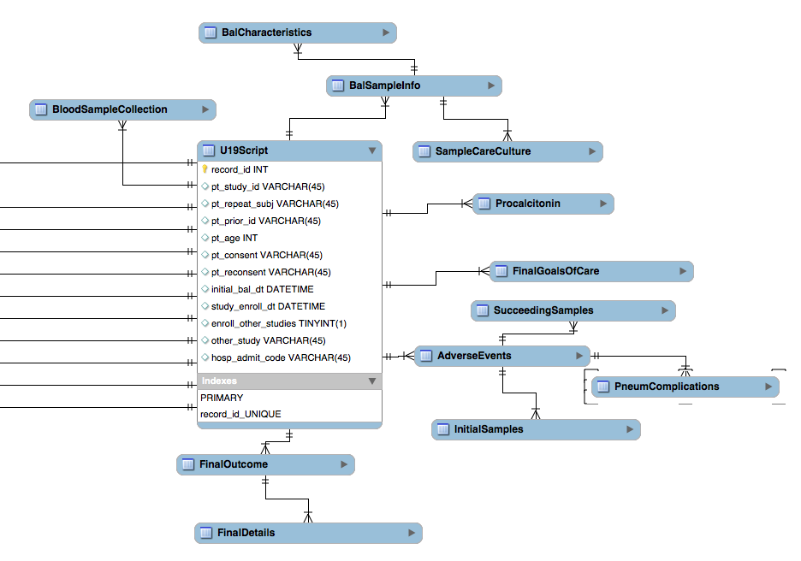
Study Records– REDCap 1B
Further Clinical details
Adverse event
Final goals of care
Final Outcome
BAL/Blood sample

Slide 16
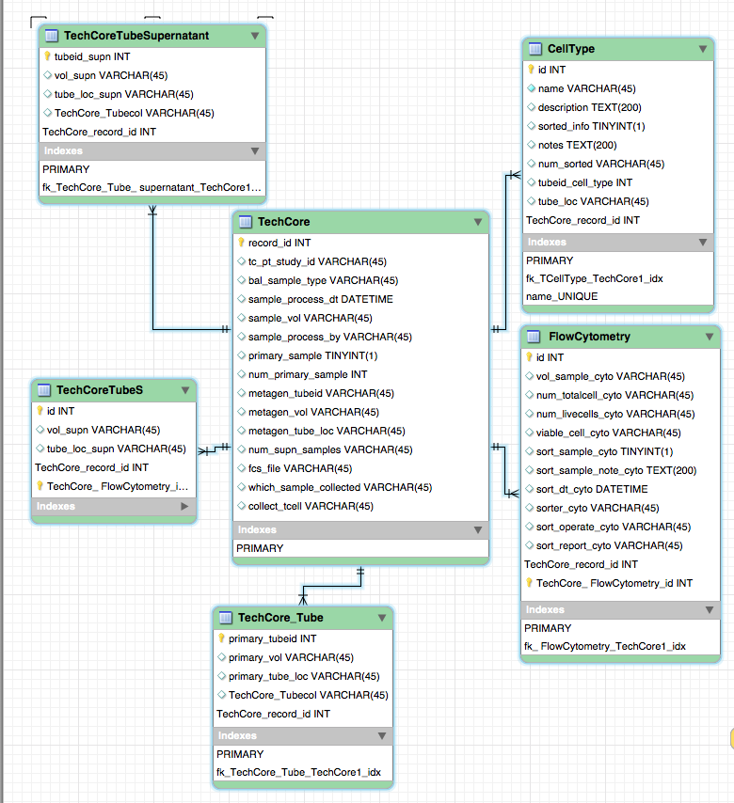
Study Records– REDCap 2
Tech core
Cell type
Tube details
Flow cytometry characteristics

Slide 17
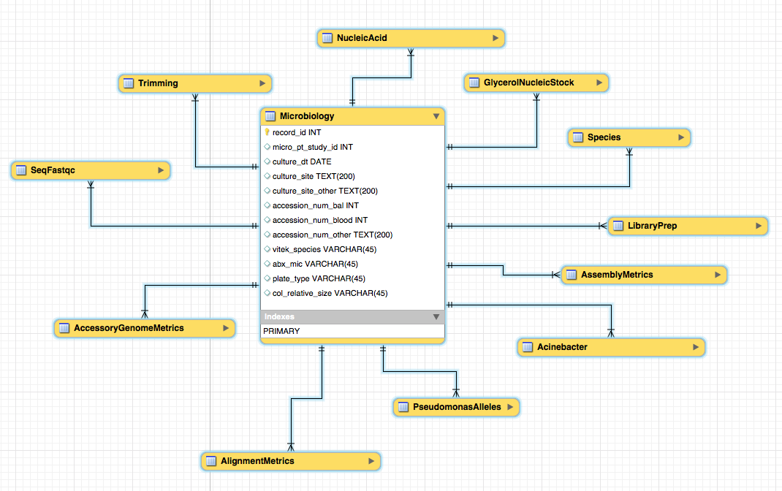
Study Records– REDCap 3
Microbiology tables
AccessoryGenomeMetrics
AlignmentMetrics
Trimming
NucleicAcid
Species

Slide 18
next steps

Slide 19
Next steps
Continue optimizing the REDCap schemas
Design the schemas for EDW Clinical data
Build the Graph DB and implement database transformation
Explore the computational choices of Azure platform
Build the pipeline from data collection to analytics
Test the pipeline with the existing patient data
Develop training materials for Azure machine learning infrastructure
Notes:
Not only SCRIPT researchers – but also researchers interested !

Slide 20
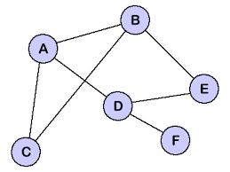
Database Transformation
Relational Database
Graph Database

Slide 21
Next steps
Continue optimizing the REDCap schemas
Design the schemas for EDW Clinical data
Build the Graph DB and implement database transformation
Explore the computational choices of Azure platform
Build the pipeline from data collection to analytics
Test the pipeline with the existing patient data
Develop training materials for Azure machine learning infrastructure
Notes:
Not only SCRIPT researchers – but also researchers interested !

Slide 22
Many thanks to:
BIDM Core – Justin B Starren, Nicholas Dean Soulakis
REDCap – Pearl Daphne Go, Todd Shamaly, …
EDW – Anna Pawlowski, Daniel Schneider
Tech Core – Deborah Winter, Alexander Misharin, Benjamin Singer
Northwestern Medicine – Helen K Donnelly, Richard G Wunderink

Slide 23
Extra slides

Slide 24
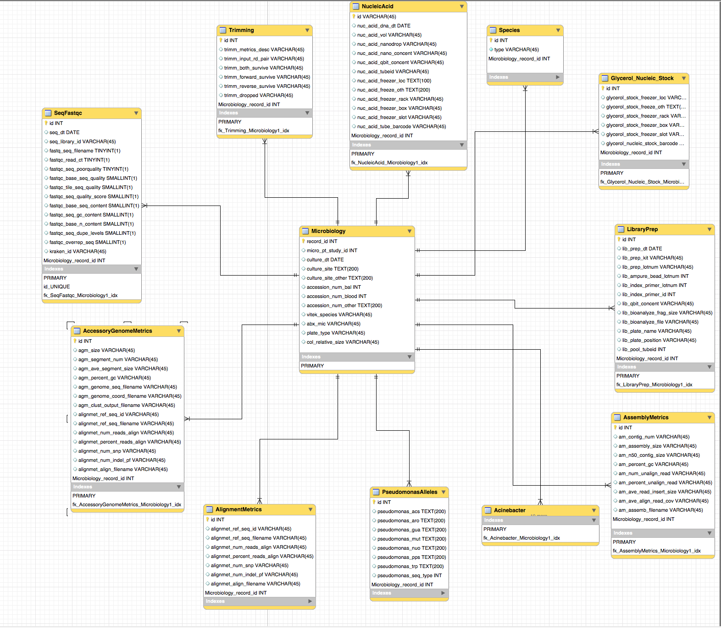
Study Records– REDCap 3
Microbiology
AlignmentMetrics
Trimming
NucleicAcid
Species

Slide 25
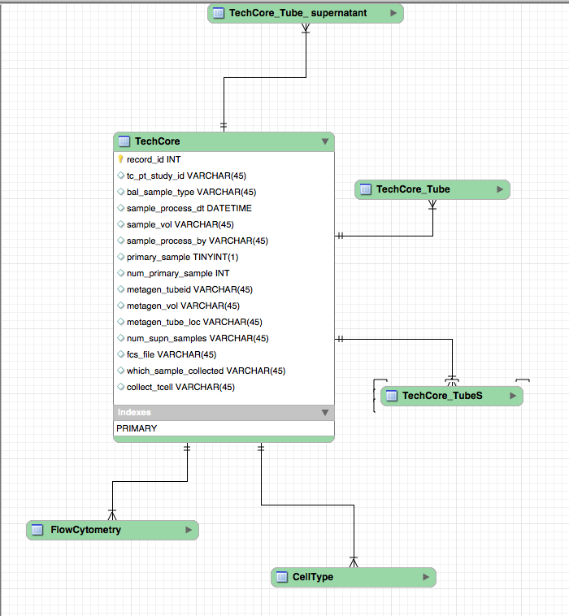
Tech core
Cell type
Tube details
Flow cytometry characteristics

Slide 26
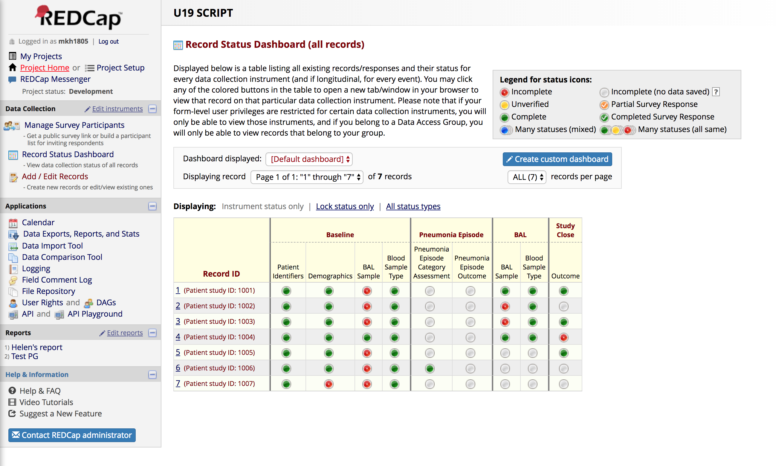
REDCap- Record Status Dashboard

Slide 27
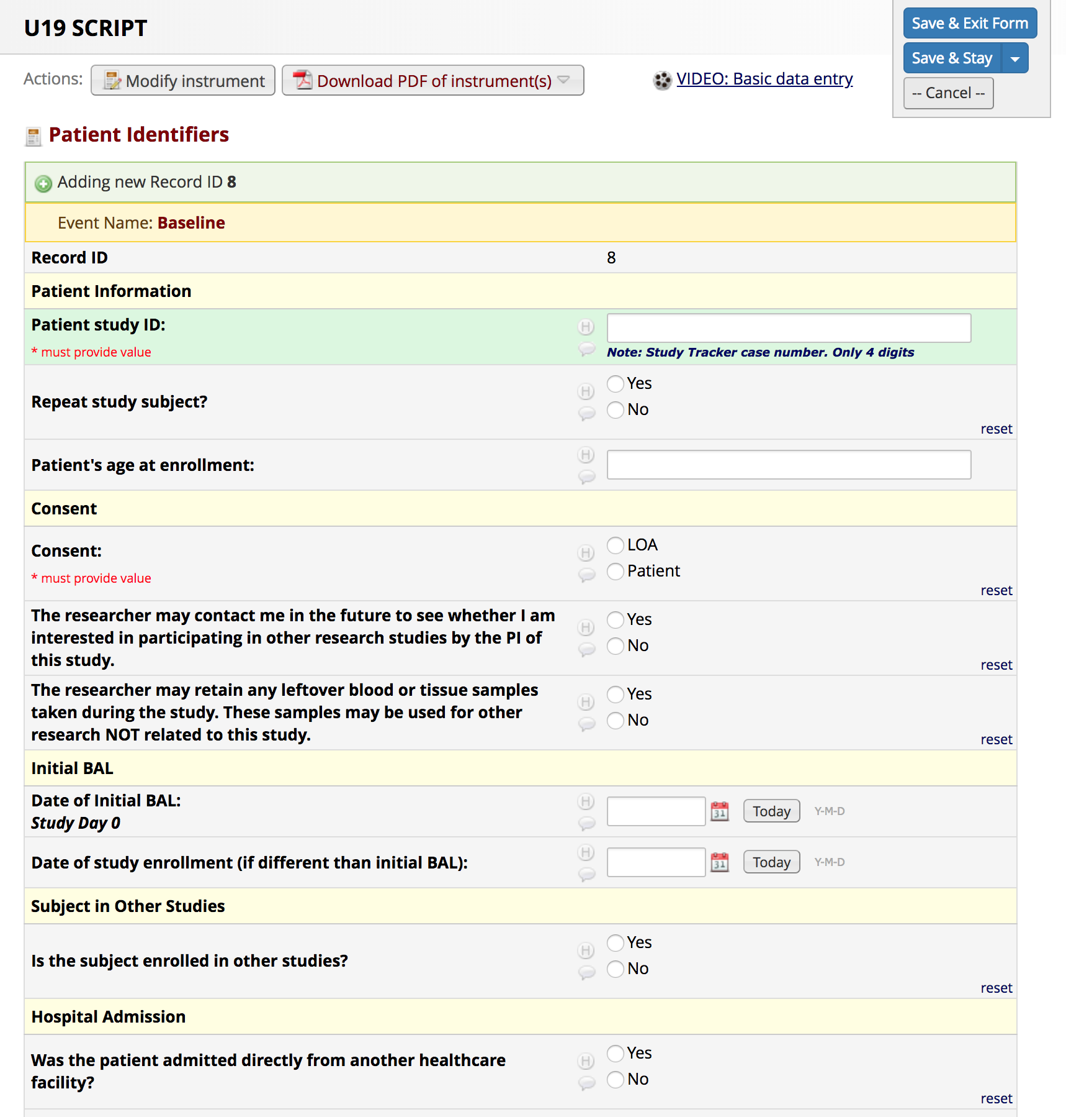
REDCap- Creating New Record

